Slide 1



DATAVERSE 2.0
CAR PRICES PREDICITION
Achraf Mansari
Nawfal Taouqi
Imad Liazidi

Slide 2


Introduction
Welcome to our presentation on predicting car prices based on certain criteria. In this presentation, we will showcase our model's approach, features, methodology, evaluation metrics, and prediction results for a panel of evaluators. Predicting car prices is a useful task in the automotive market, and our model aims to provide accurate and reliable predictions to help car buyers and sellers make informed decisions.

Slide 3






Methodology
01
02
03
04
Explore the data
Pre-process and clean the data
Train the model with different algorithms
Compare the different algorithms, and find the most accurate

Slide 4

Features | Data Type | Number of unique values | Number of null values
Manufacturer | String | 7 | 0
Price | Float | --- | 128
Body Style | String | 6 | 0
Fuel Efficiency | Float | - | 0
Engine Volume | Float | --- | 109
Powertrain | String | 4 | 0
License Status | String | 2 | 0
ManufactureYear | Integer | --- | 0
Variant | String | 279 | 0
Location | String | 11 | 0
Distance Covered | Integer | --- | 0
Gearbox | String | 2 | 0
Owner_Type. | String | 4 | 0

Slide 5
Pre-process and clean the data
Remove null values from the dataset
We perform Label Encoding and One Hot Encoding on the non numeric columns
Splitting the cleaned data into 75% for training and 25% for testing

Slide 6
Algorithms Used
Linear regression
Lasso regression
LightGBM
Linear regression is a simple and widely used supervised learning algorithm for predicting a continuous outcome.
Lasso regression is a linear regression variant that includes a regularization term to prevent overfitting.
LightGBM is a gradient boosting framework that uses tree-based learning algorithms.

Slide 7
Algorithms Used
Random Forest Regression
Decision Tree Regression
XGB Regressor
XGBoost (Extreme Gradient Boosting) is a popular gradient boosting algorithm.
Random Forest is an ensemble learning method that builds multiple decision trees during training.
Decision tree regression involves creating a tree-like model of decisions based on features.

Slide 8
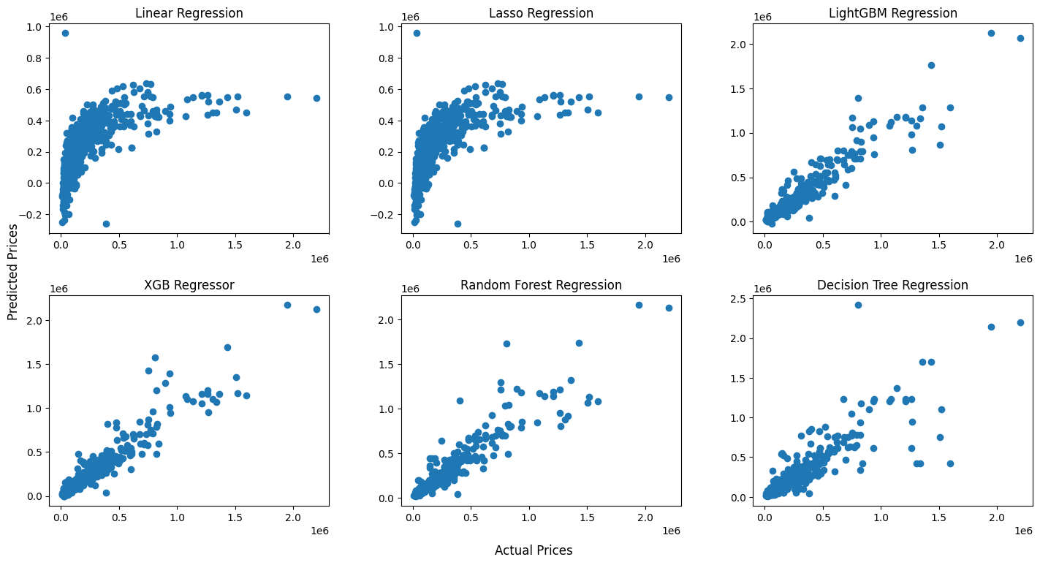

Slide 9
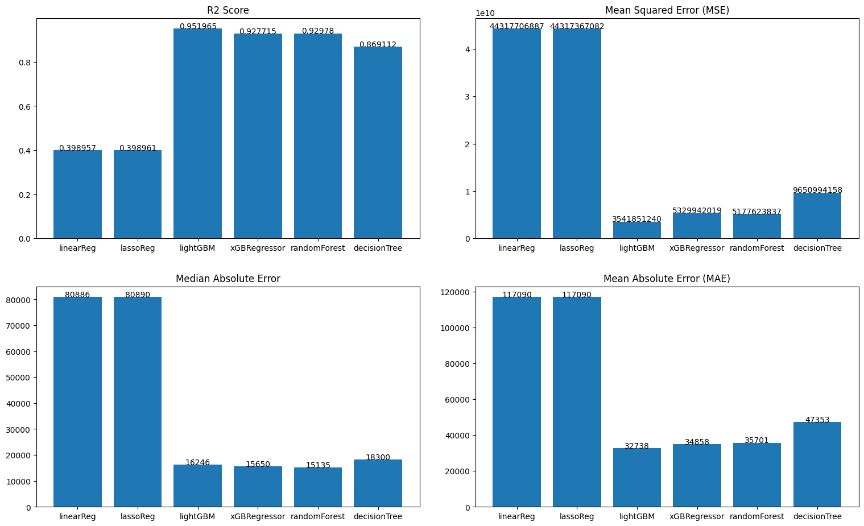

Slide 10
Test results
95%
91%
80%
67%
LightGBM without null values [Test]
LightGBM with null values [Test]
LightGBM without null values [Validation]
LightGBM with null values [Validation]

Slide 11
THANK YOU
For watching this presentation

